Slide 1

Web application design Year 3-Semester 2 ComicsApp presentation
Buzduga Ionut-Gabriel

Slide 2
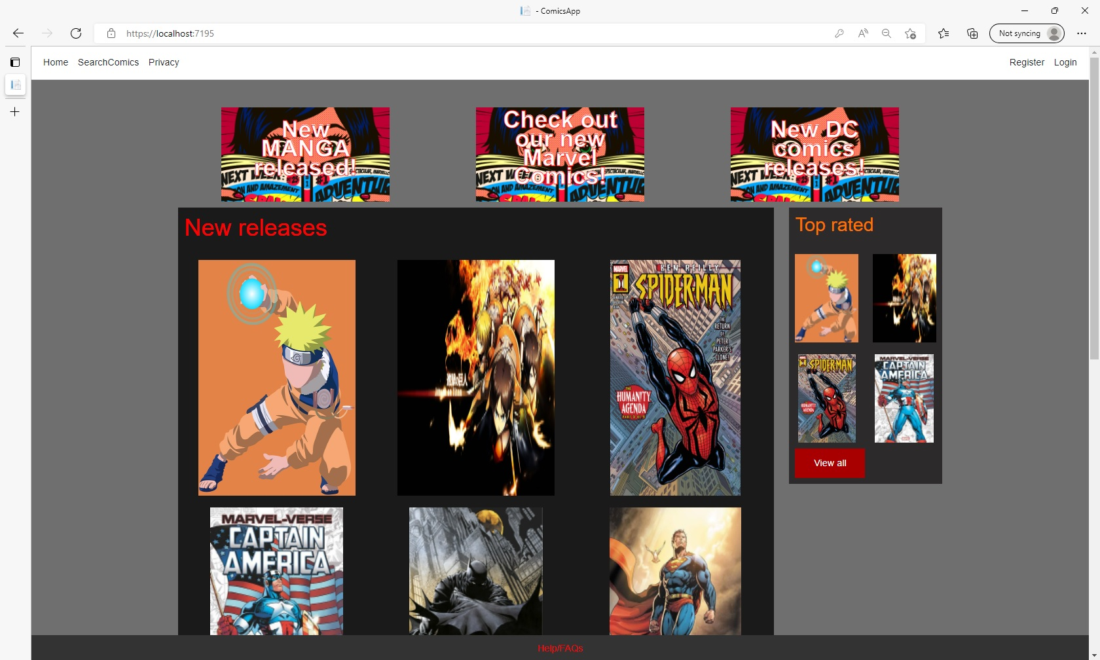
This is the home page where any unregistered user will be send when starting the application

Slide 3
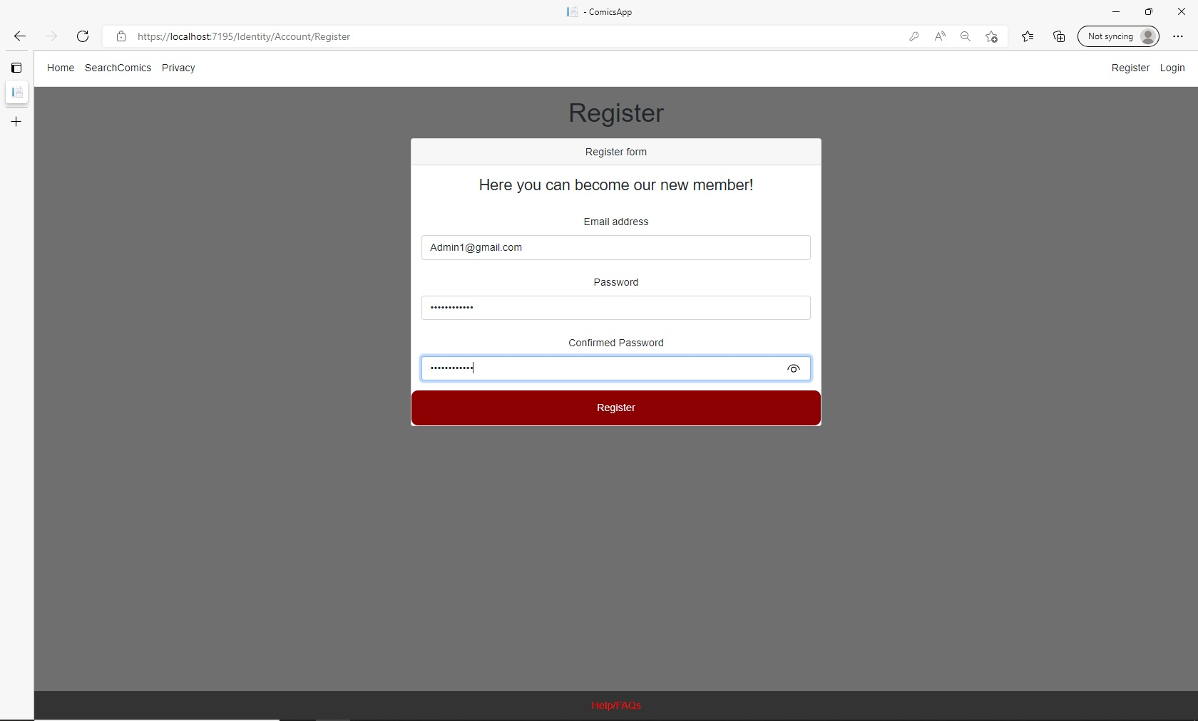
After accessing the register page, the admin/user needs to create an account

Slide 4
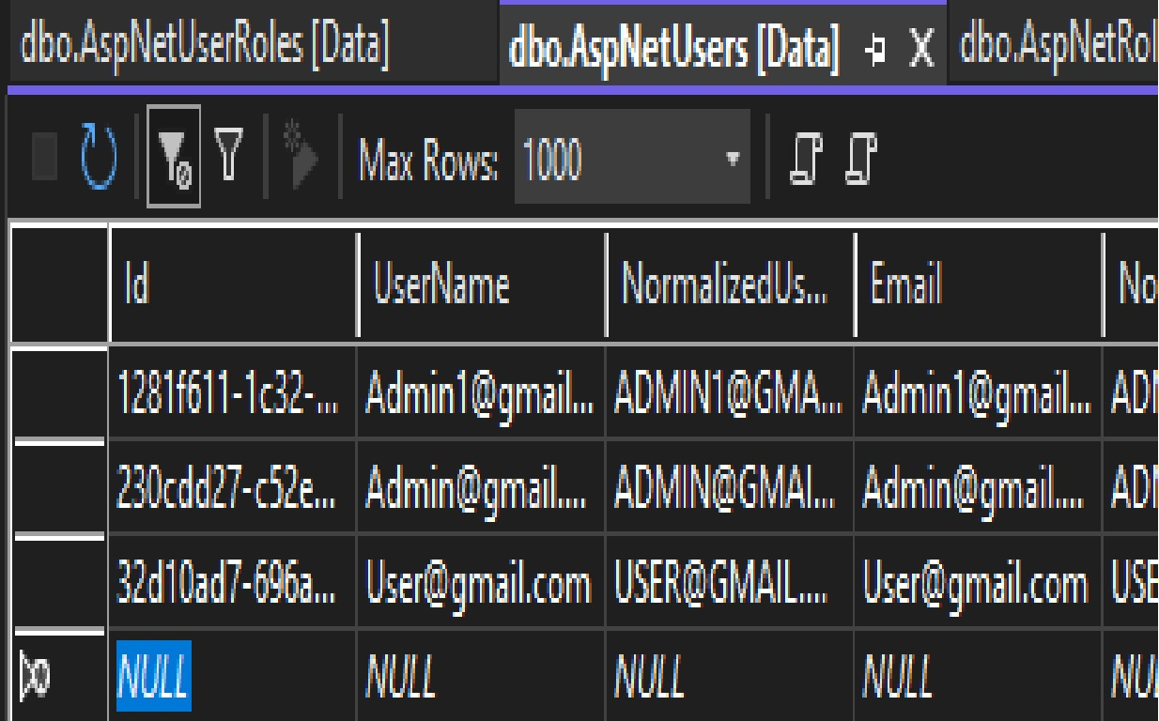
After registering its account, the newly created user will appear in the database

Slide 5
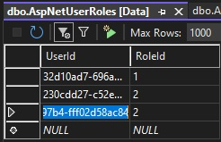
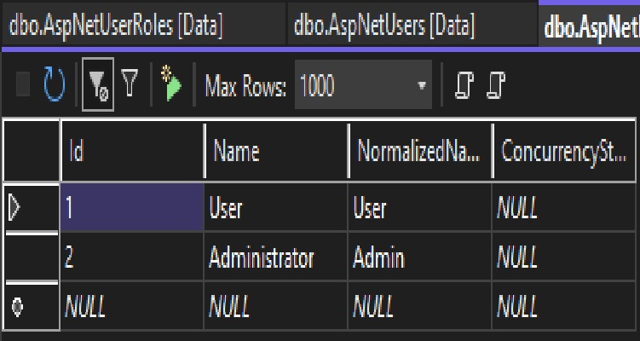
The database administrator then needs to assign one of the two identity roles for that specific user based of the UserID

Slide 6
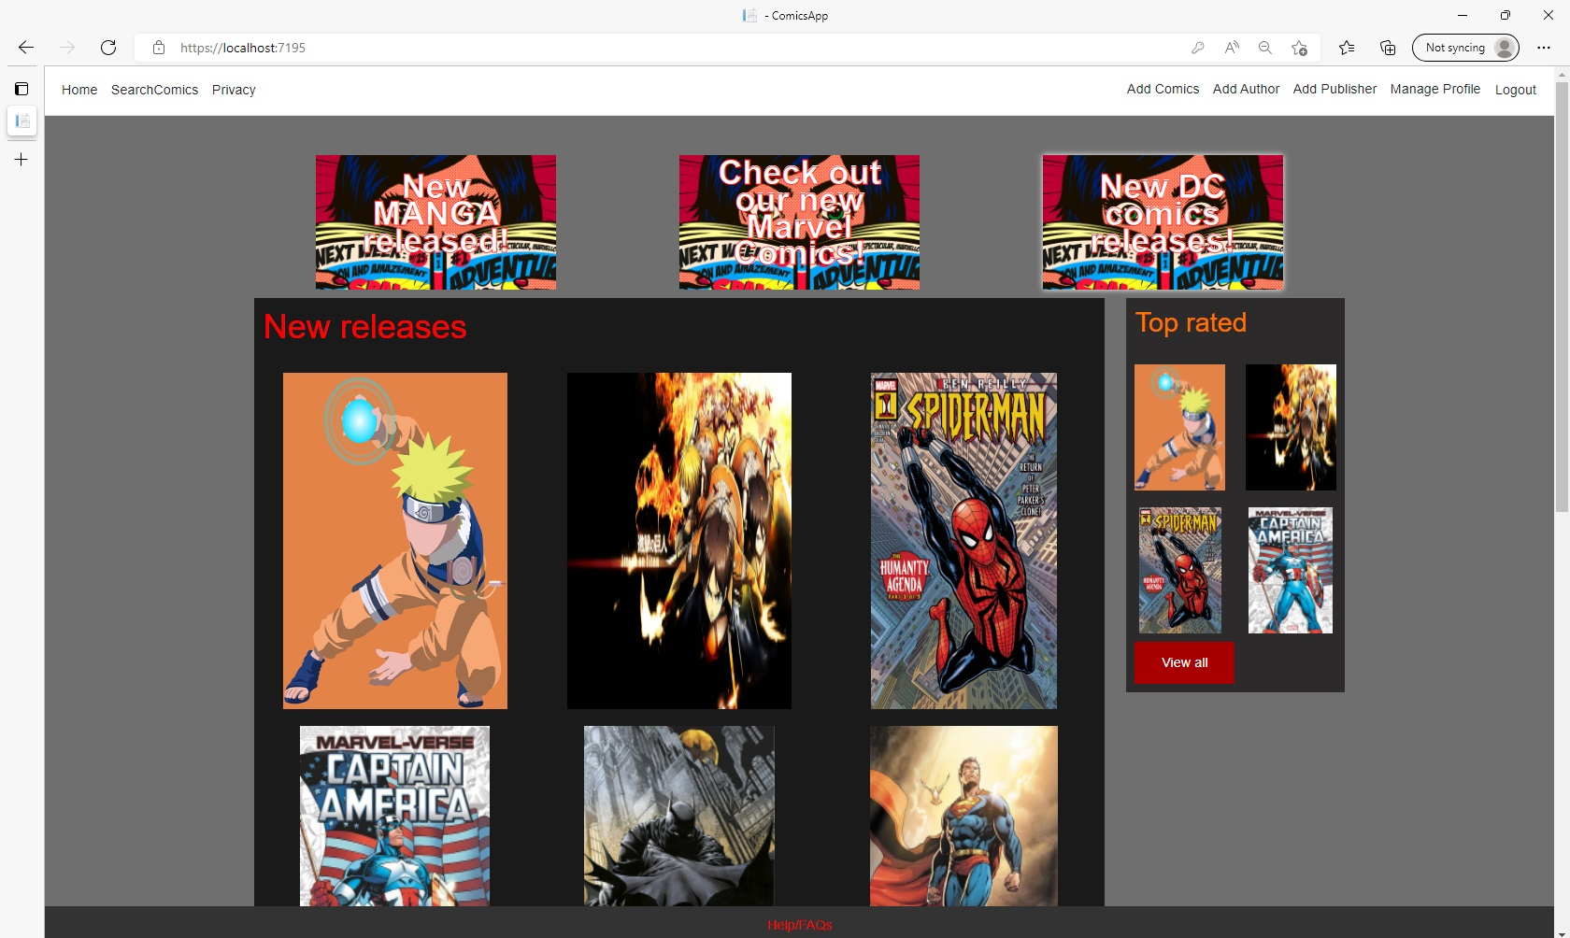
Only the admin can manage comics, authors and publishers that can be accessed separately and displayed on the home page

Slide 7
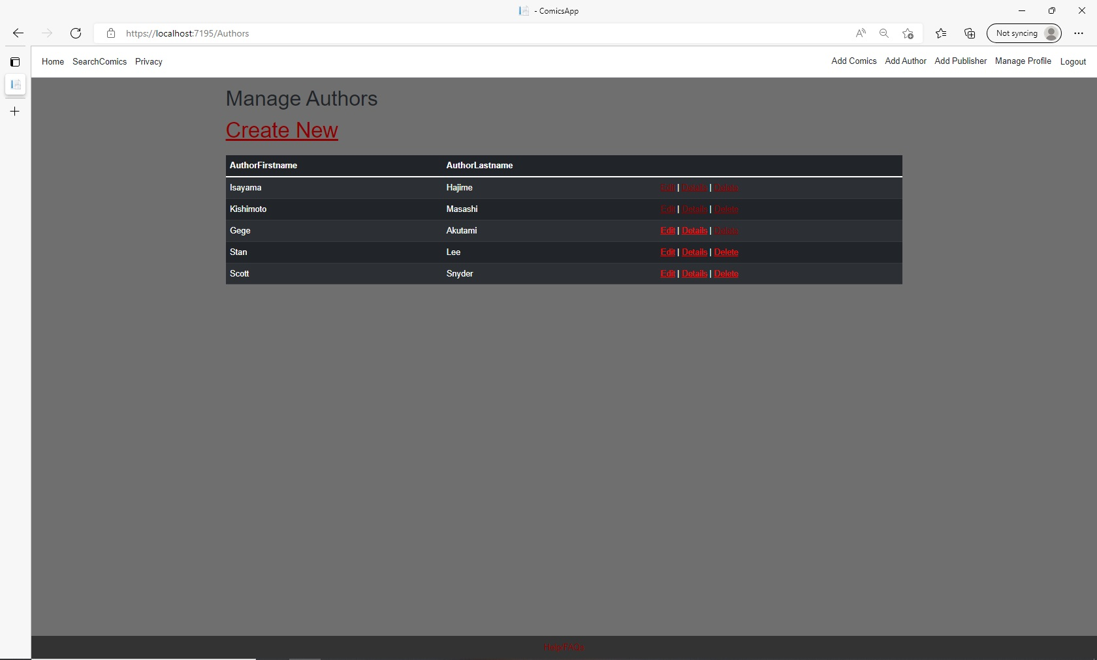
All the three pages for Comics, Authors and publishers follow the same template. All the Information is displayed in a table, and you can choose to create, edit, delete for each entry. To add a comic, you must first add an author and publisher that will correspond to it

Slide 8
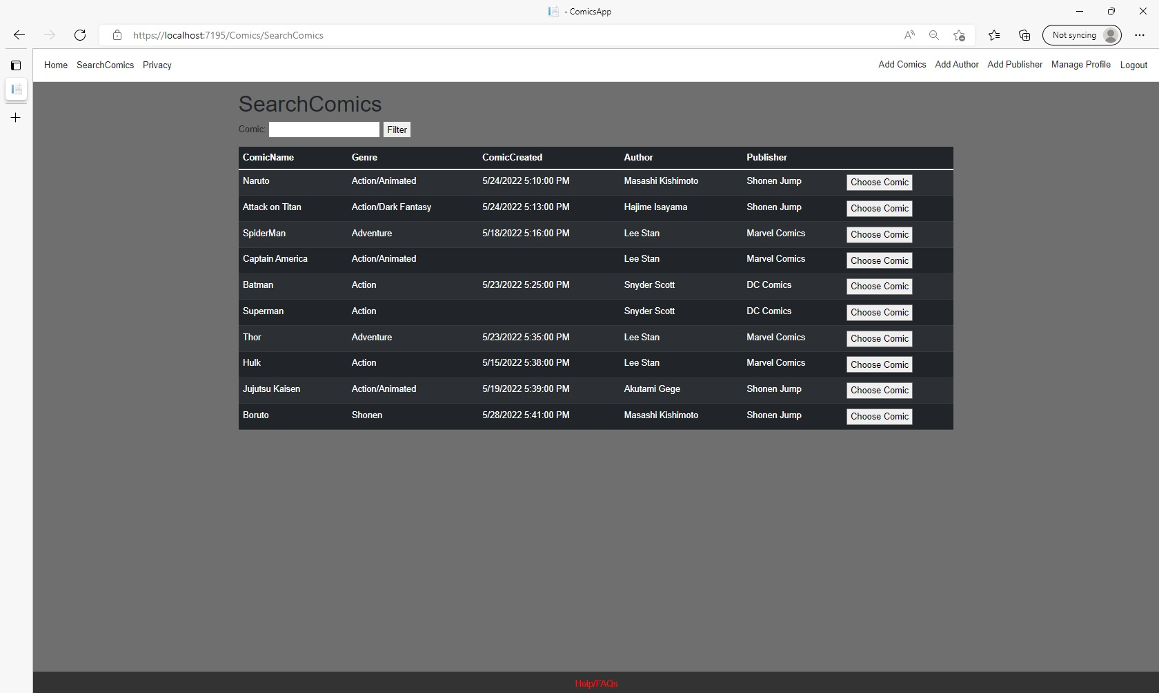
In the SearchComics section from the navbar you can search a comic by name and then choose to go to its page

Slide 9
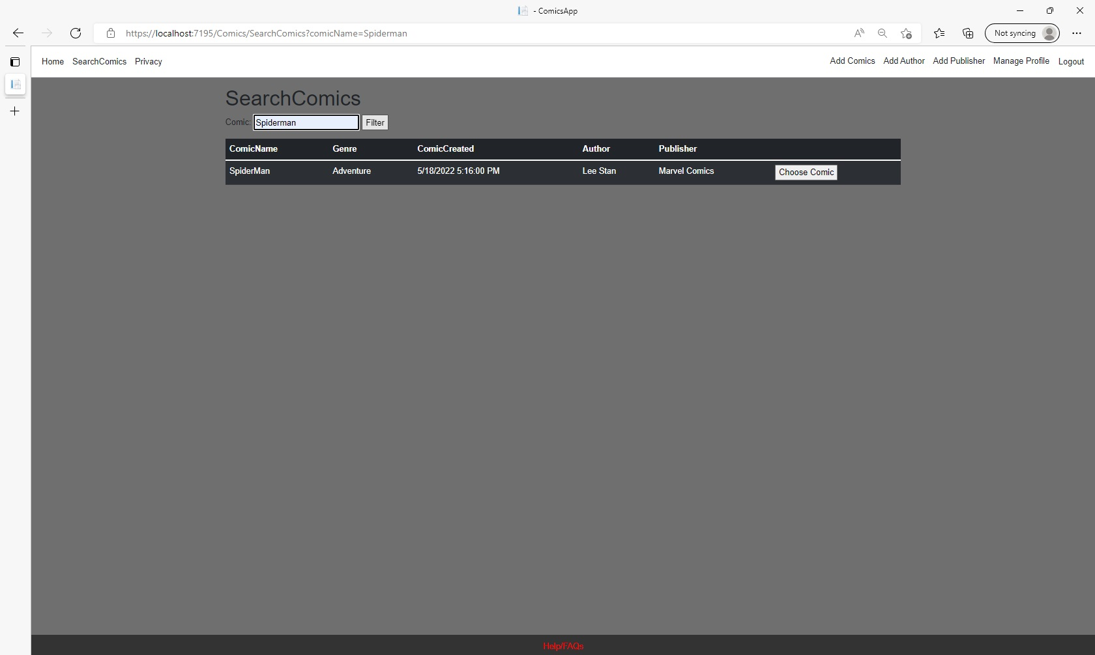
Here we searched the Comic by its name, and it filtered the results.

Slide 10
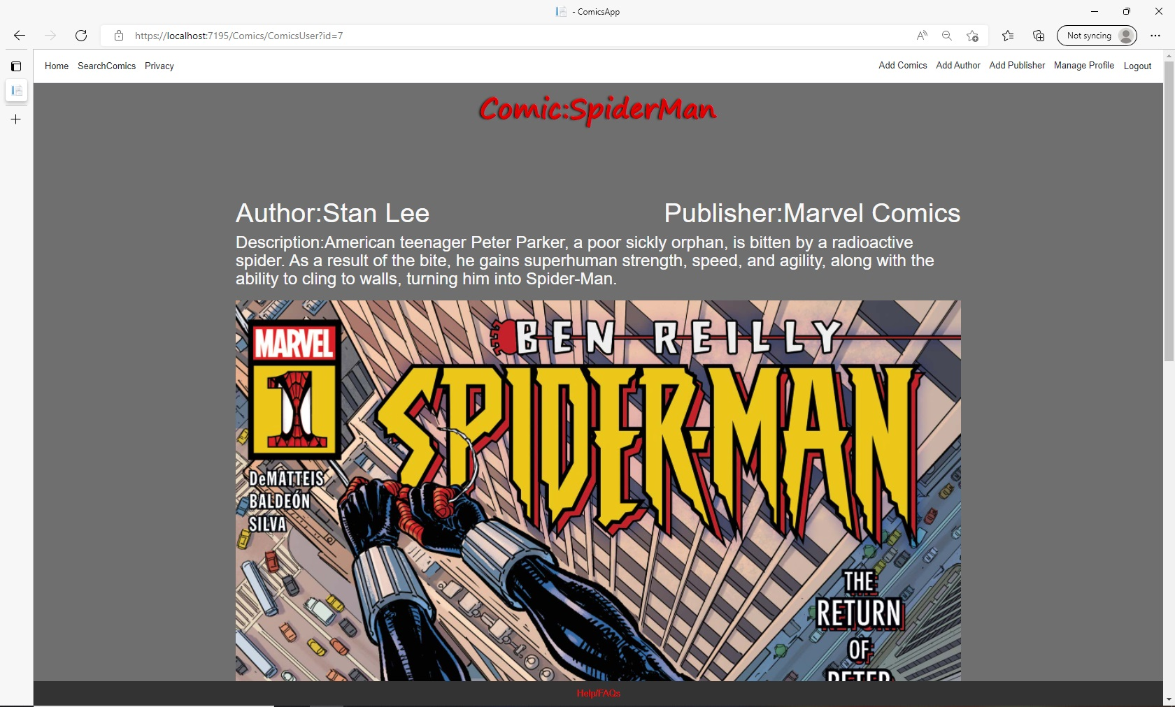
Each comic will have the information displayed in this format.

Slide 11
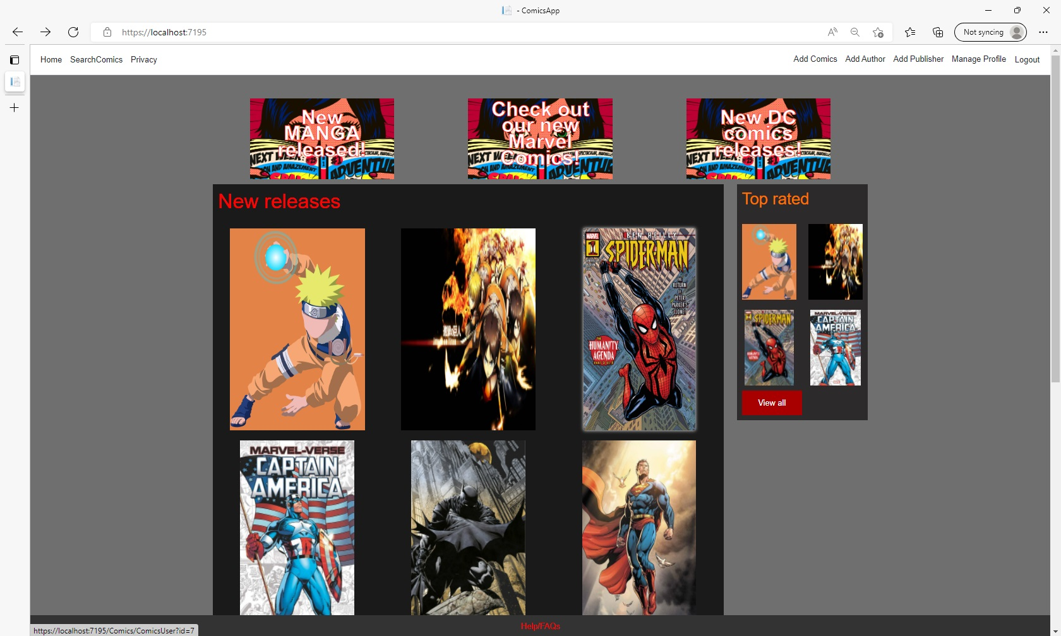
In a similar fashion we can access a comic straight from the homepage if we click on it.

